Slide 1
Enhancing Stock Price Prediction: A Multi-Model Framework Integrating Technical Indicators and Sentiment Analysis
Adwaidh Prakasan: 2467108 Supervisor: Dr. Karthikeyan
Mentor: Dr GANESH KUMAR R
Final Review

Slide 2
Abstract
A multi-model strategy that improves the predictive power of stock prices by combining time-series analytics with external market indicators.
The system allows five base prediction methods: LSTM, XLSTM, SVM, ARIMA, and SARIMA.
A stacking procedure uses linear regression as a meta-model, alongside a voting ensemble method, to link the base models.
The stacking arrangement achieved the lowest total MAPE of 0.6027% for MSFT and the highest Directional Accuracy of 75.86% for GOOGL.

Slide 3
Introduction
A country's stock market acts largely as a replica of its economy and is monitored globally by investors.
Market structure has changed dramatically, moving away from crude statistical tests toward multi-dimensional forecasting.
National markets are primarily driven by market sentiment and are highly influenced by social media and news activity.
Integrating qualitative human factors with technical metrics helps counter investment risks and improves return on investment (ROI).

Slide 4
Literature Review
Key studies:
Moving Averages (MA) and Momentum Oscillators (RSI) are widely used, with MA rules performing well in specific markets.
Aggregate sentiments from platforms like Twitter and StockTwits correlate with market indices; advanced NLP (Transformers) outperforms simple lexicons.
Combining LSTM with other models (e.g., CNN, MLP) or features (news, technicals) has been shown to improve accuracy and ROI.

Slide 5
Literature Review
Research gaps identified:
Few studies merge highly advanced sentiment embeddings with complex technical and fundamental indicators into a single input layer.
Current ensemble models often utilize less enriched or standardized input features, missing the opportunity to train robust stacked models on deeply extracted features.

Slide 6
Problem Statement
Financial time series data is characterized by high volatility, non-linearity, and chaotic behavior, making accurate prediction difficult.
There is a lack of comprehensive feature integration; few models merge advanced sentiment embeddings with complex technical indicators into a single input layer.
Existing ensemble models often employ less enriched or standardized input features, missing the opportunity to leverage deeply extracted metrics.

Slide 7
Objectives
Create a framework combining statistical, machine learning, and deep learning paradigms.
Extract comprehensive technical indicators (SMA, EMA, RSI, MACD) and integrate them with normalized sentiment scores from NLP models.
Gauge model capability using standard metrics including RMSE, MAE, MAPE, and Directional Accuracy (DA).

Slide 8
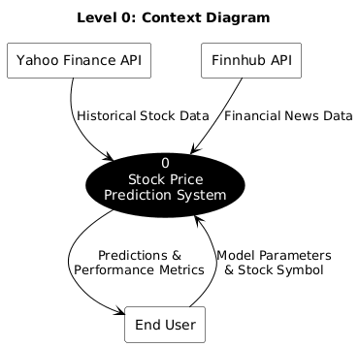
Objectives

Slide 9
Methodology & Data Flow Diagram
Historical data is retrieved using the yfinance API, capturing OHLCV values over a configurable window.
Features are normalized via Min-Max scaling, with strict train/test splitting to prevent data leakage and look-ahead bias.
Financial news is processed via a RoBERTa-based pipeline to yield discrete sentiment values (0, 1, 2).
The framework uses a "one-step-ahead" rolling forecast (walk-forward validation) to re-calibrate predictions with recent actual data.

Slide 10
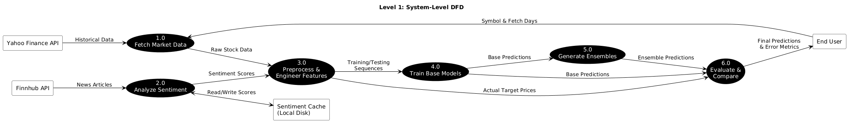
Methodology & Data Flow Diagram

Slide 11
Implementation
Built using Python, TensorFlow/Keras for neural networks, and Scikit-learn for machine learning and ensemble meta-learners.
Tested on major stocks (AAPL, MSFT, GOOGL, etc.) utilizing dynamic time spans based on user lookback inputs.
Implemented caching to store large sentiment pipelines and specific rate limiting (55 calls/60 seconds) to manage external API constraints gracefully.

Slide 12
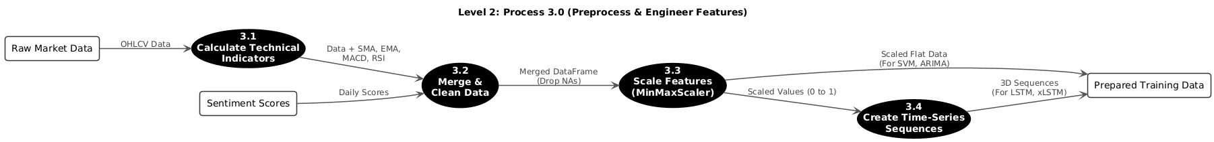
Implementation

Slide 13
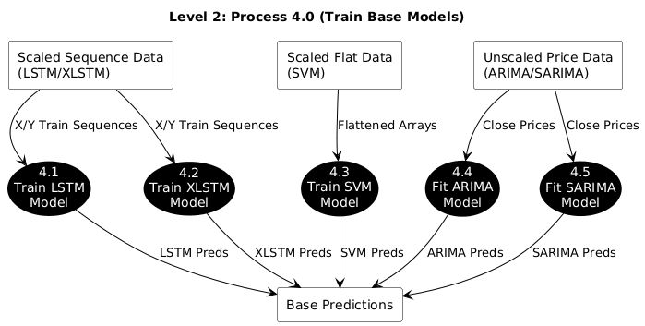
Implementation

Slide 14
Results
Ensemble methods, particularly Stacking, consistently achieved superior results compared to individual base models.
The Stacking model recorded the lowest RMSE, MAE, and MAPE across almost all analyzed stocks.
Stacking achieved a MAPE of 0.74% for GOOGL, 0.60% for MSFT, and 0.72% for JNJ.
The system prioritized Directional Accuracy, with Stacking peaking at 75.86% for GOOGL and 68.96% for V.

Slide 15
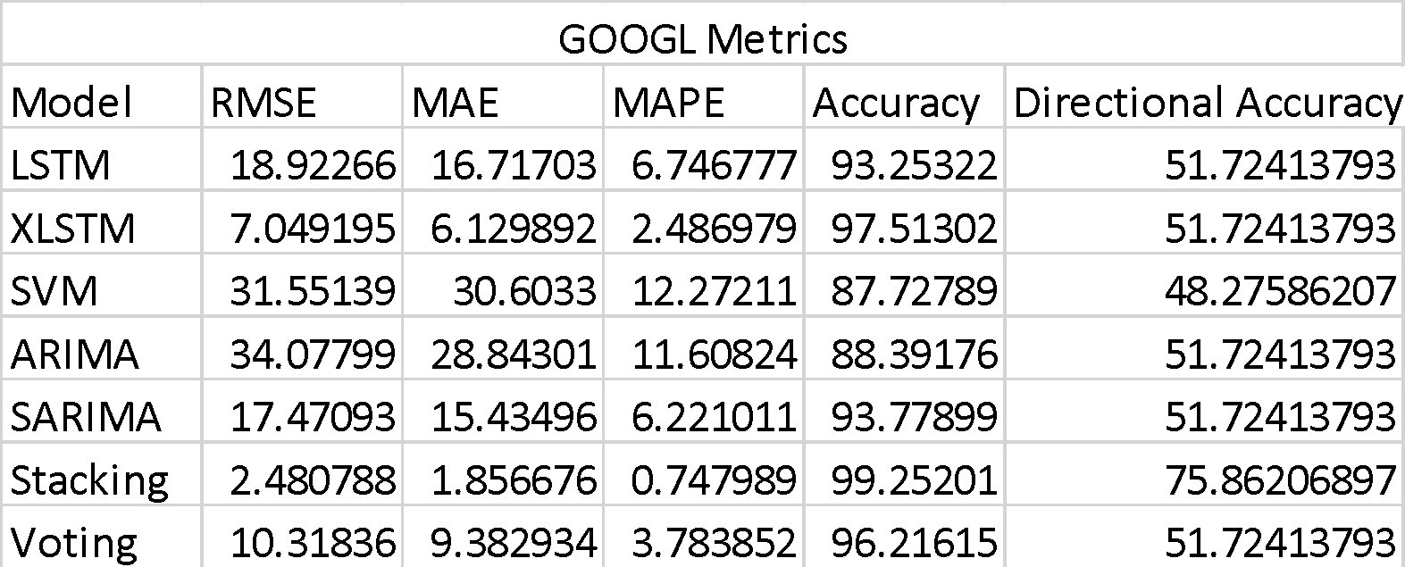
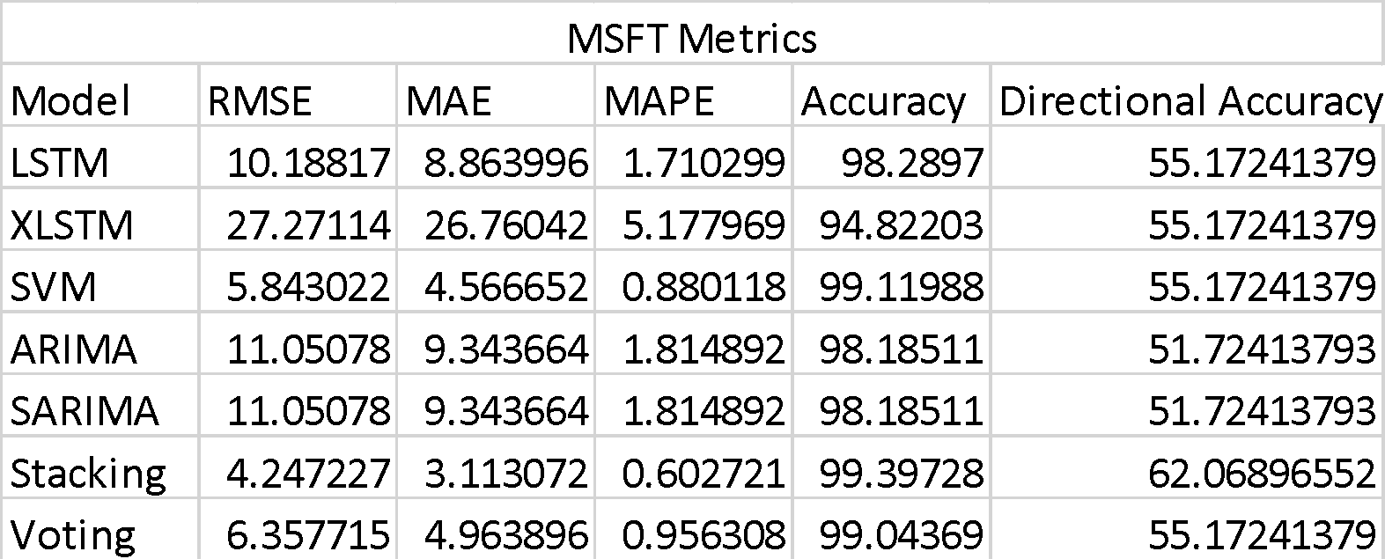

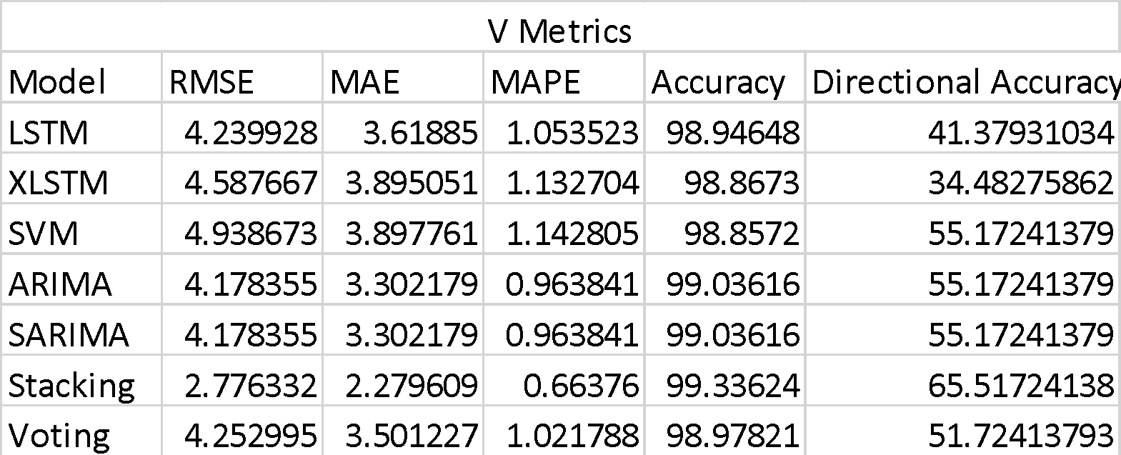
Results

Slide 16
Conclusion and Future Work
The thorough integration of heterogeneous machine-learning, statistical, and sentiment-analysis methods provides strong evidence for highly accurate financial forecasts.
Future work will include a focused study comparing models trained with the full feature set against those trained only on technical features.
Plans to expand sentiment sources beyond news summaries to include social media and earnings call transcripts.
Exploring the use of Transformer or Attention-based neural networks to better capture long-term dependencies compared to traditional LSTMs.

